Slide 1

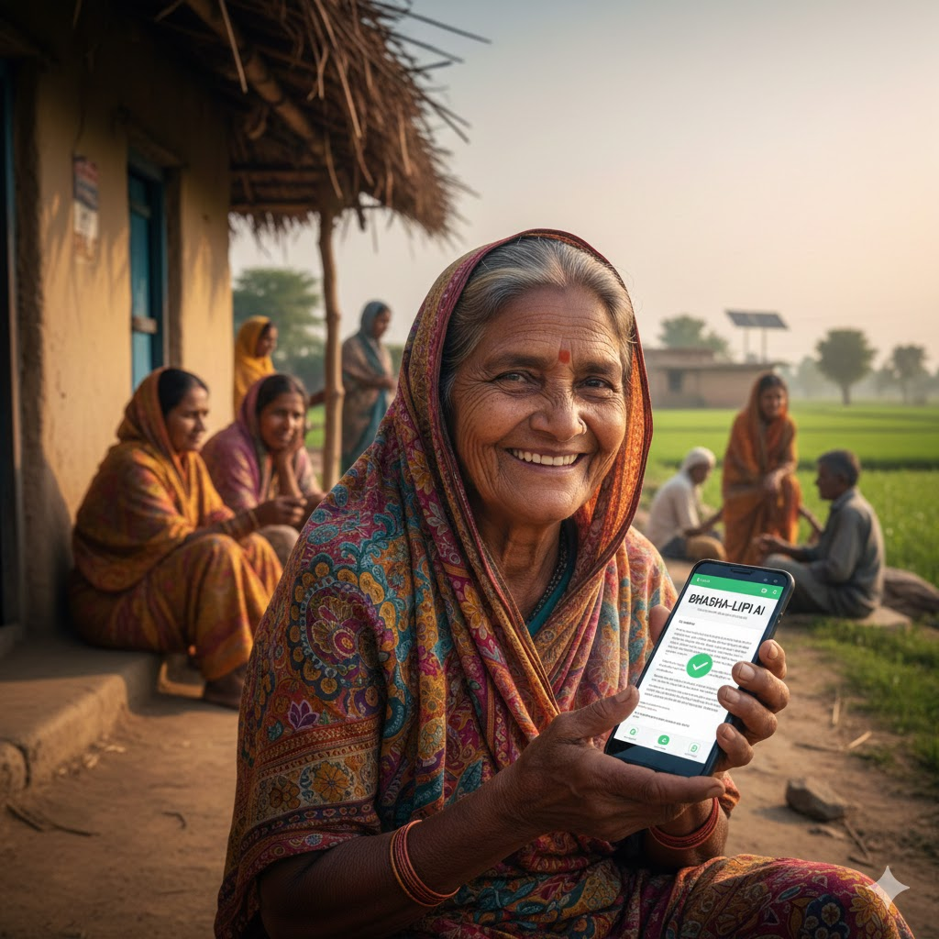


InnVedX Code Hackathon
Team Lead Name-Rajat Yadav
Members name-Raghvendra Pandey, Raghvendra Kumar
Problem statements- Bhasha-Lipi AI: Overcoming the Barrier of Informational Exclusion.
Track-Build for Bharat – Open Innovation

Slide 2


PROBLEM & SOLUTION
The Crisis of Information Asymmetry:
Legal Vulnerability: Citizens sign documents they cannot read, leading to exploitation in land and civil disputes.
Health Hazards: Medication non-compliance in rural clusters due to English-only dosage instructions.
The Middleman Trap: High costs and privacy risks associated with hiring physical translators for basic government benefits.
The Bhasha-Lipi Intervention:
Context-Aware NMT: Unlike generic translators, our pipeline is fine-tuned for Administrative Jargon and Legal Lexicons.
Cognitive Accessibility: It doesn’t just translate; it digitizes and simplifies, reclaiming regional languages as valid mediums for scientific and legal data

Slide 3


TECH STACK & METHODOLOGY
Core Development Stack:
Backend Framework: Django
  Selected for its MVT (Model-View-Template) architecture to ensure robust data persistence and built-in security features for handling user documents.
AI Translation Engine: Bhashini ULCA API
  The primary engine for Neural Machine Translation (NMT), specifically tuned for the linguistic nuances of 22+ Indian languages.
Optical Character Recognition (OCR): Tesseract / Google Vision
  High-precision engines used for converting physical document images into digital text strings.
Frontend UI: Bootstrap 5
  A mobile-first, responsive framework designed to provide a seamless experience for users on low-end smartphones.
Technical Methodology:
Image Pre-Processing (OpenCV):
  Utilizing OpenCV layers for de-skewing, noise reduction, and contrast enhancement to ensure high OCR accuracy from mobile-captured photos.
Linguistic Extraction:
  High-fidelity OCR pipelines trained to recognize complex Indian scripts, including Devanagari, Tamil, and Telugu.
Neural Translation Pipeline:
  Text is processed via Lekhaanuvaad models to ensure the translation maintains the proper administrative and cultural context.
Database & Audit Trail:
  Django Models manage the storage of translation history, allowing for user-access retrieval and system audit logs.

Slide 4

USP & KEY FEATURE
Strategic USP (Unique Selling Proposition)
Linguistic Data Sovereignty
  Powered by the Government of India’s Bhashini Ecosystem.
  Ensures 100% Data Privacy and National Security by processing sensitive documents within sovereign digital borders.
Audio-Visual Inclusivity
  Integrated Neural Text-to-Speech (TTS) engine.
  Empowers the 25% of the population with lower literacy rates by allowing them to hear translations in their native dialect.
Key Technical Features
Intelligent Layout Preservation
  Maintains the original document structure (stamps, signatures, and headers).
  Enables seamless cross-referencing between the translated text and the physical original.
Offline-First Architecture
  Local caching of translations for low-connectivity rural zones.
  Ensures reliability in "Dark Zones" where 4G/5G penetration is unstable.
Bhasha-Lipi AI bridges the gap between 'Virasat' and 'Vikas' by turning linguistic heritage into a tool for _- Social progress. We are moving beyond simple translation to deliver true Socio-Linguistic Justice for every Indian citizen.
CONCLUSION-

